Slide 1

Mode of action (MOA) prediction for chemical perturbagens using static OMICS feature
Aubhishek Zaman, PhD
Lab meeting March,2023

Slide 2
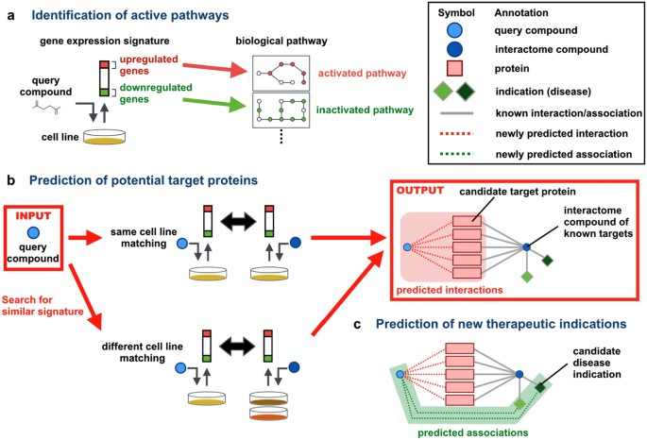
1. Bioactive compound screenings:
Easy to perform
Combinatorial compound libraries are easy to scale
Significance and challenges
2. Current modus operandum:
Gene set enrichment analysis
Weights are much less comprehensive
Less quantitative more qualitative
A group of gene prediction
3. Multiple elastic net regression (MLR):
Quantitative
Deep learning methodology
Train and test needs to be optimized often
Individual biomarker nomination
Iwata et al. 2017

Slide 3
1. Compound response information is relatively sparse
Compared to OMICS features
N/P ratio problem
Results in overfitting: the solution is unique for the dataset and fails on unknown test data
Regularized regression: why do we care
Zaman et al. 2022

Slide 4
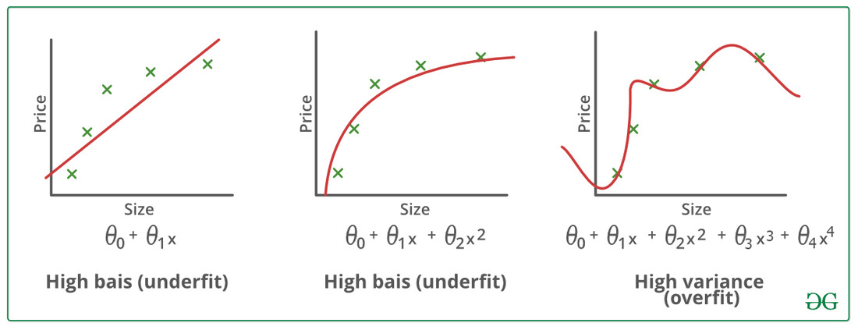
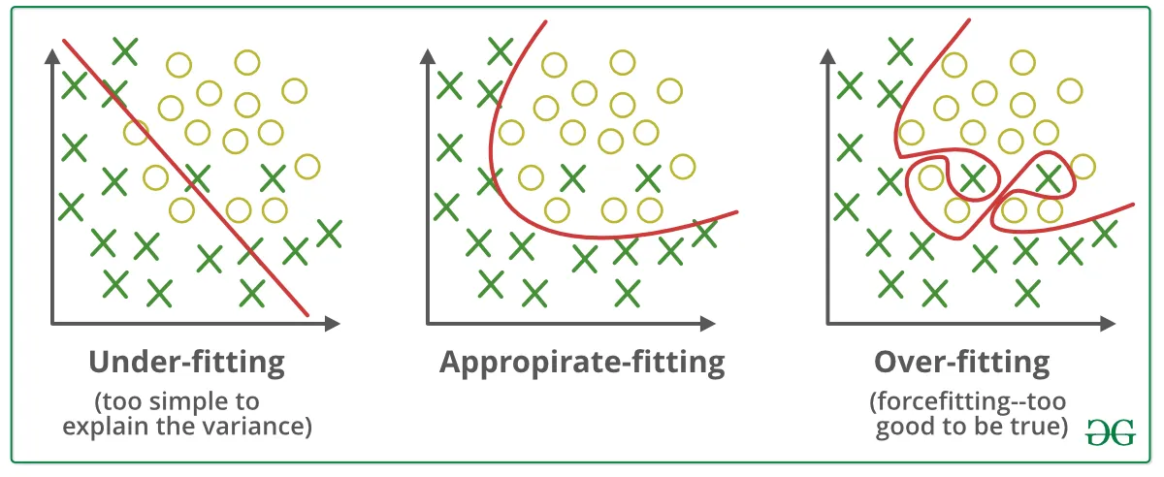
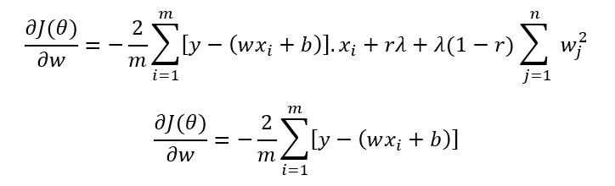
1. Compound response information is relatively sparse
Compared to OMICS features
N/P ratio problem
Results in overfitting: the solution is unique for the dataset and fails on unknown test data
Regularized regression: why do we care

Slide 5
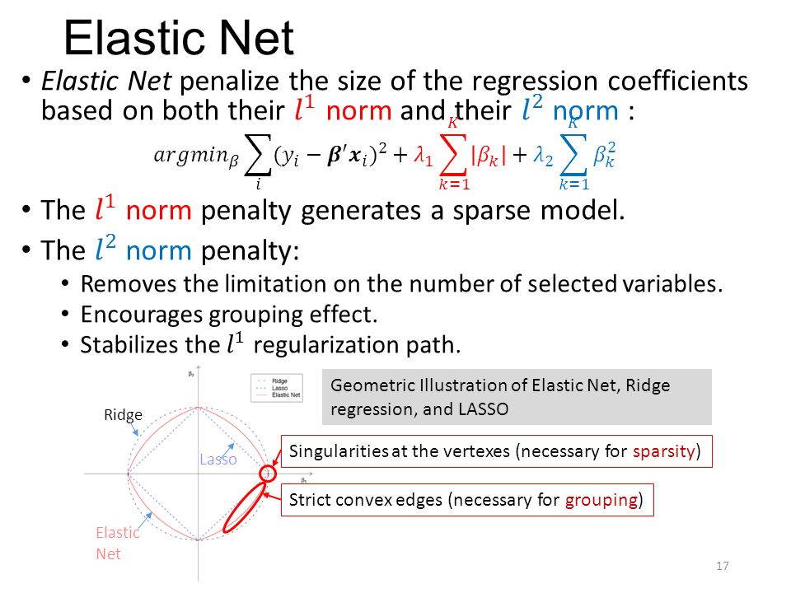
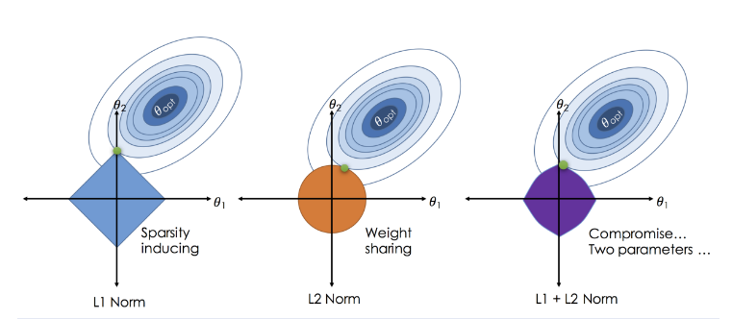
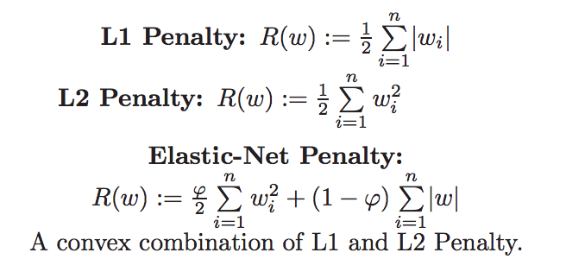
Regularized regression: why do we care
L1 (Lasso) regularization: penalty term that lowers the complexity by minimizing the number of non-zero coefficients
L2 (Ridge) regularization: penalty term that lowers the complexity by making the weights more sparse

Slide 6
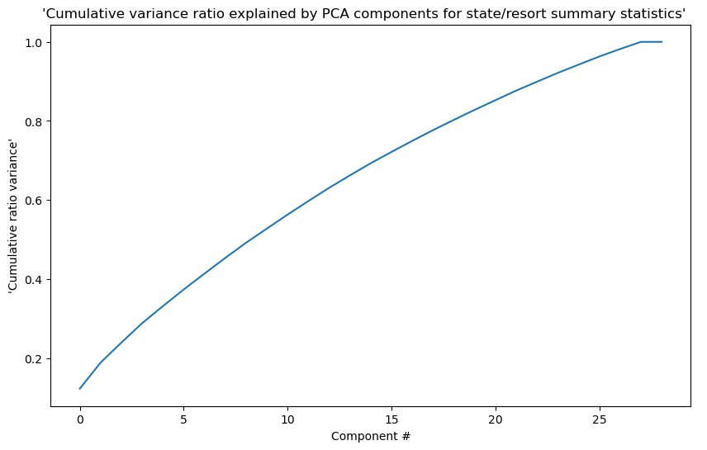
Regularized regression: A theoretical PCA shows complexity cannot be reduced without reducing the dimension

Slide 7
Establishing the Elastic net
1. Concept
Dataset1: Each column indicates a cell sample (cell line/tumor tissue) and each row indicates a feature. For example, Transcriptomic Features ~ 55,000 rows, 100 columns.
Dataset2: Response of a drug for each cell sample (cell line/tumor tissue)
For a single drug; we have to create a response (X= target) versus feature (Y= regressors).
Features (~55,000)
LogAC50

Slide 8
Steps: Data prep
1. Data acquisition
GEO
PDHK1 project
Literature mining
Features (~55,000)
2. Data wrangling and exploratory analysis
PCA
Summary stat
3. Data prep
Null value replacement
Standardization
Scaling and column normalization
LogAC50

Slide 9
Steps: Modeling
1. Test-train split
GEO
PDHK1 project
Literature mining
2. Elastic net fit
3. NMF fit

